Slide 1
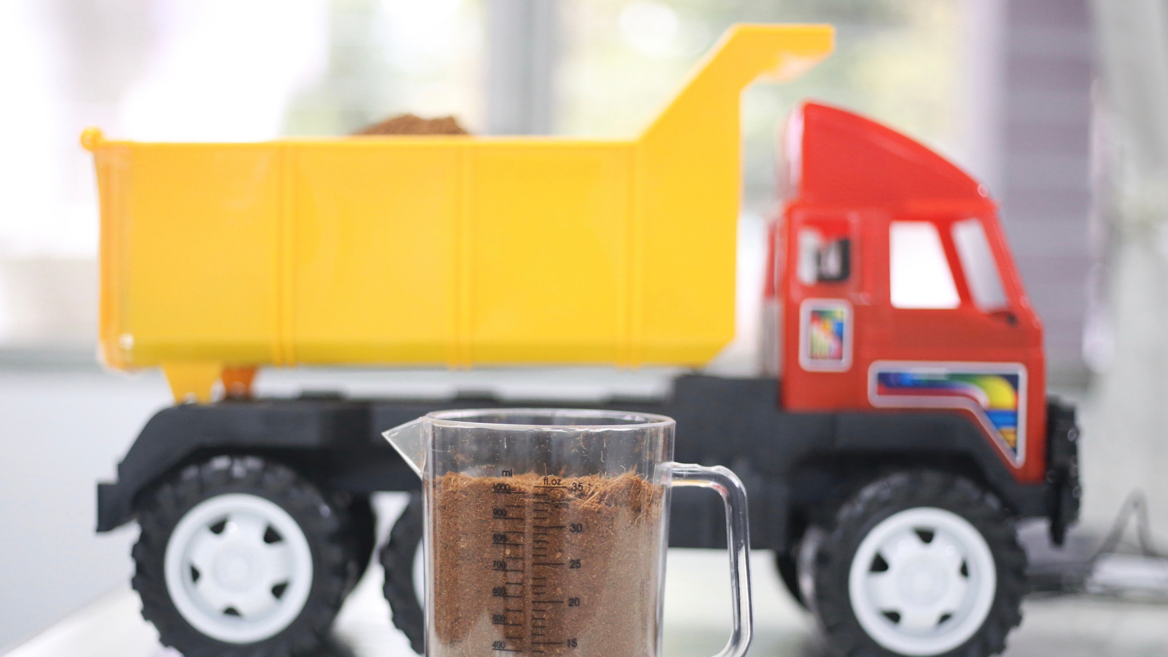
Sensor System for
Measuring Volume
of Materials on Truck
Chanwira Viteepanya 610615007
Chanawat Jantawang 610615008

Slide 2
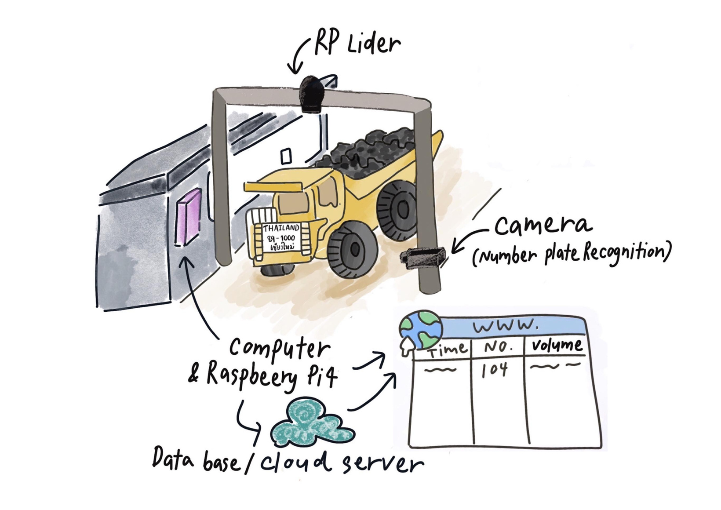
Background

Slide 3
Objective
- Can create a system that can measure the volume on truck.
- Can show the volume that calculate from distance sensor on website.
- Can read truck plate NO. and send truck information on website.

Slide 4

Scope
Hardware Scope
- Measuring volume from the truck.
- Detecting truck number.
Software Scope
- Show the information on the website.
User Scope
- Staffs that work in mining and customer that buy the stone.

Slide 5
Expected outcomes
- Get a system that can measure volume in quantity.
- Get a system that can show the information on the website.
- Get a system read truck plate NO. and send truck information on the website.

Slide 6



Software Technology
Using for calculation volume that receive from sensor.
Using for showing data on website.
Using for training ANPR model to detect number plate.

Slide 7


Software Technology
Using for extract the text.

Slide 8
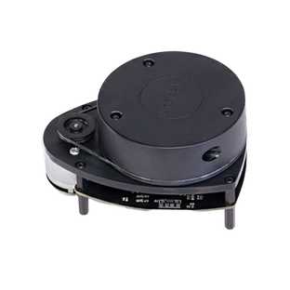

Hardware Technology
RPLIDAR A1M8-R6
Webcam
Write a code for calculating the volume on an rplidar.

Slide 9
Experiment
- RPlidar receive value then will send data
to computer for calculate the volume.
- Data and volume will show on the website.

Slide 10

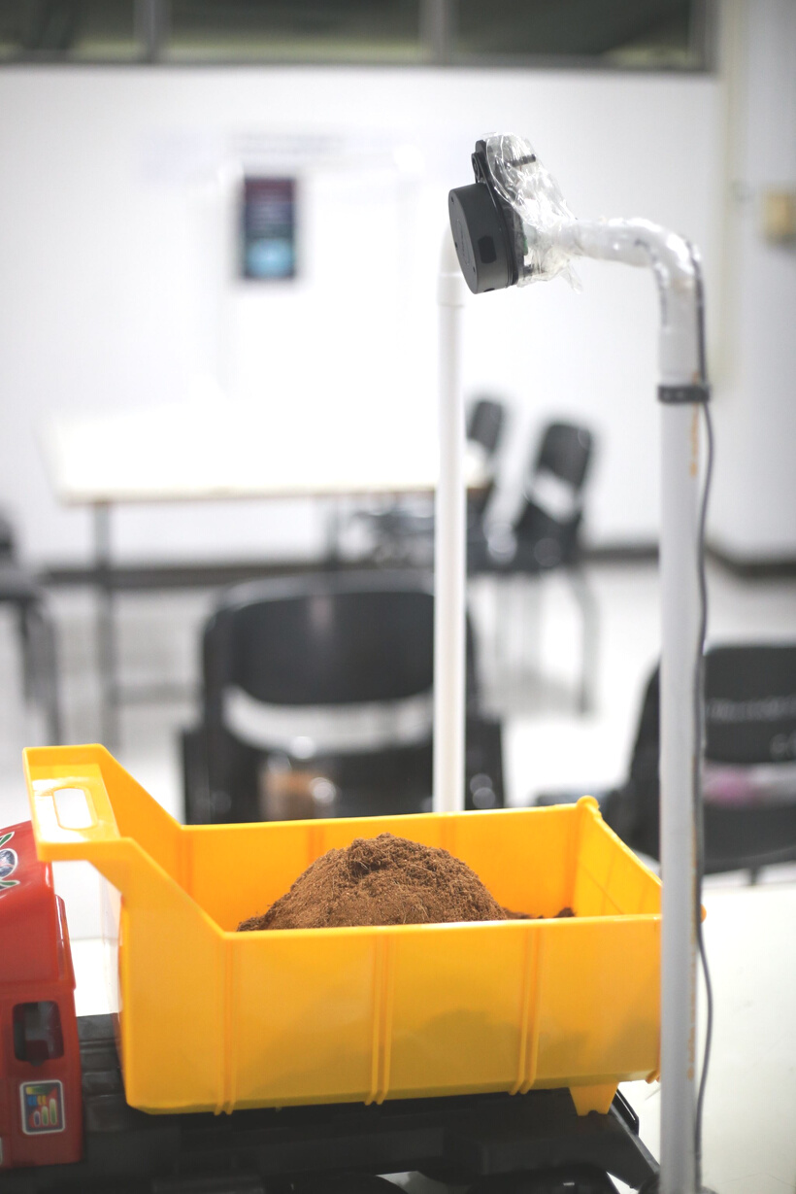
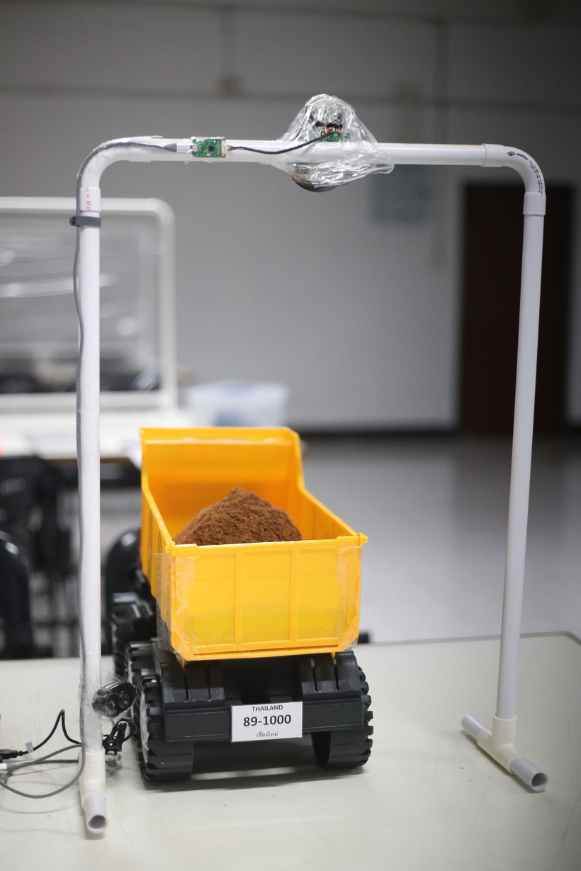
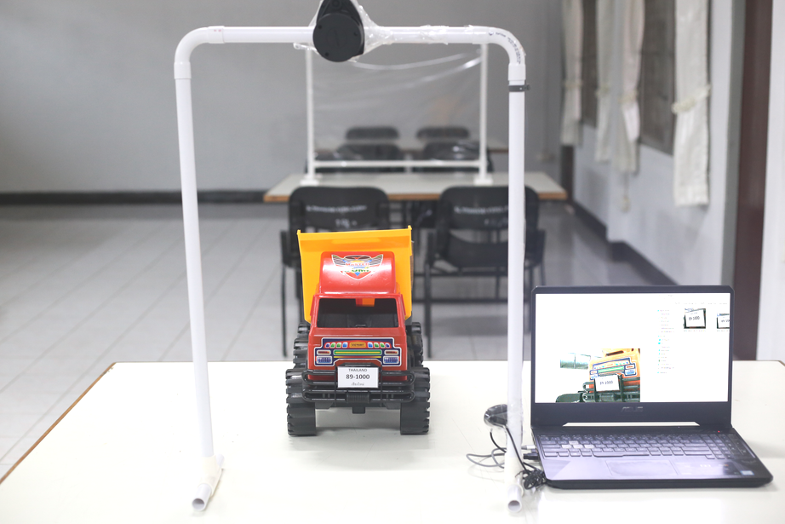
Model
Scale 1: 6557 compare with ISUZU NPR75HXXXU

Slide 11


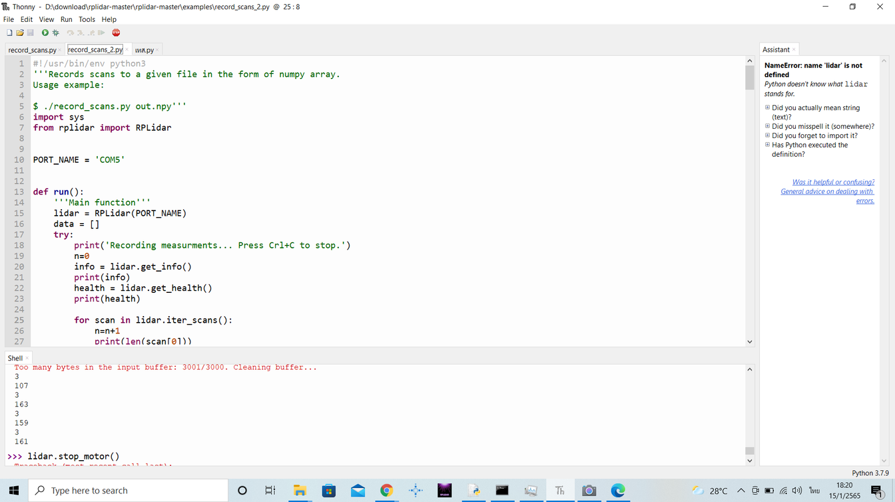
How it measure the Volume ?
Measured by measuring the volume of the material behind the actual truck and be compared to measure the results with the values obtained from the program.

Slide 12
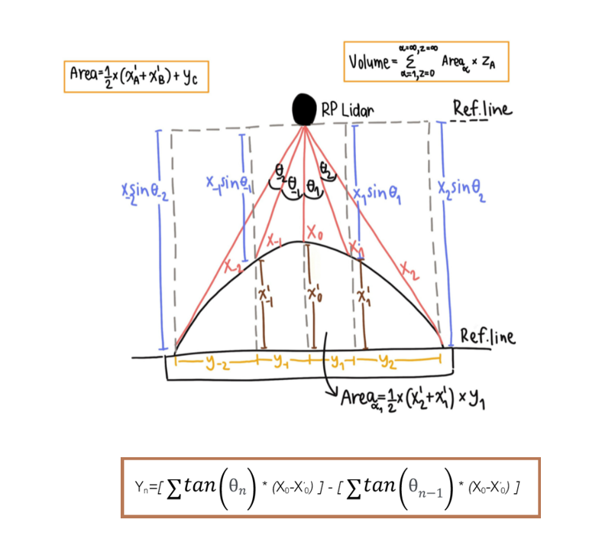
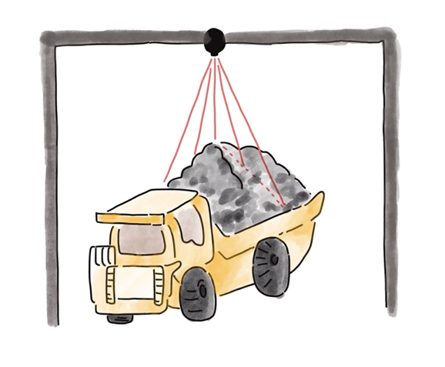

Slide 13
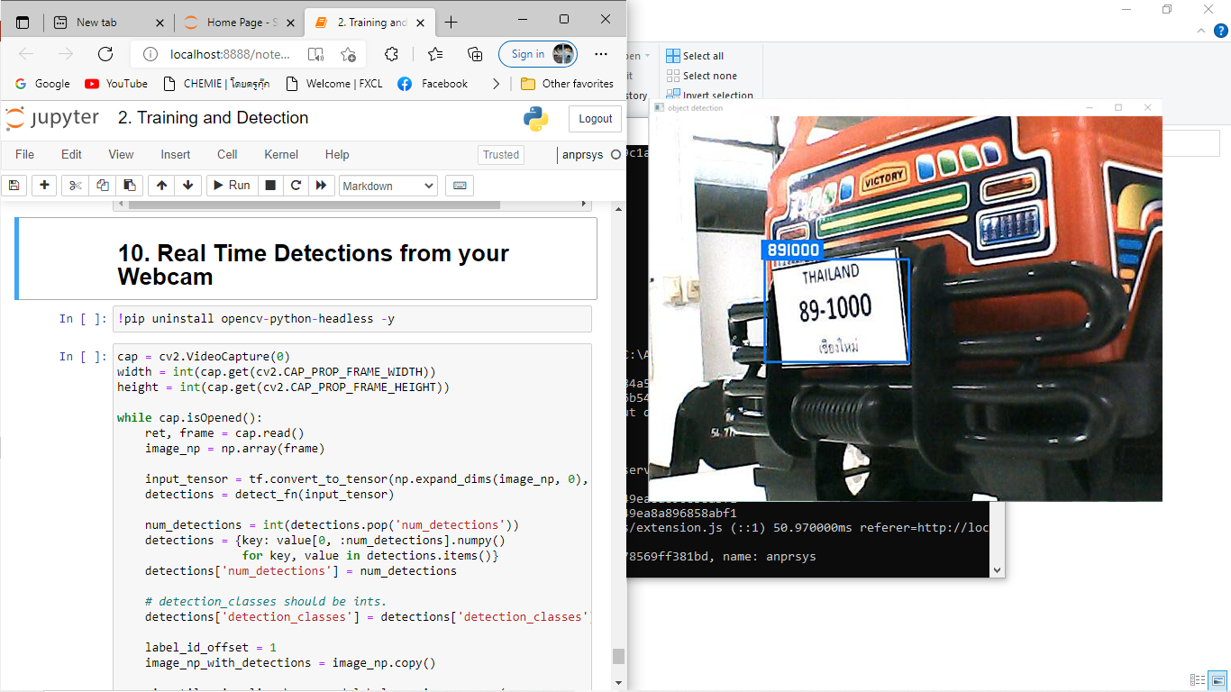
Autonomic number plate recognition

Slide 14
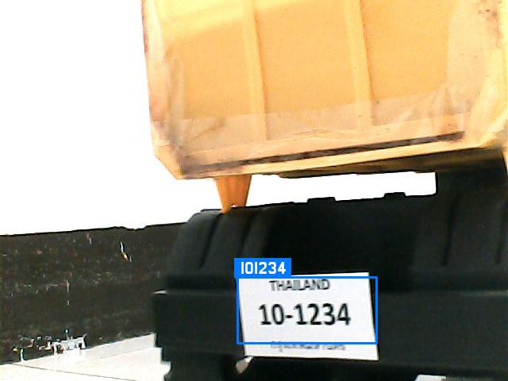
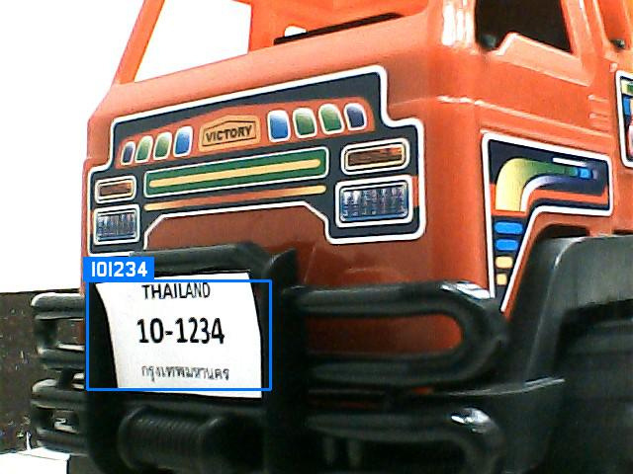
Autonomic number plate recognition

Slide 15
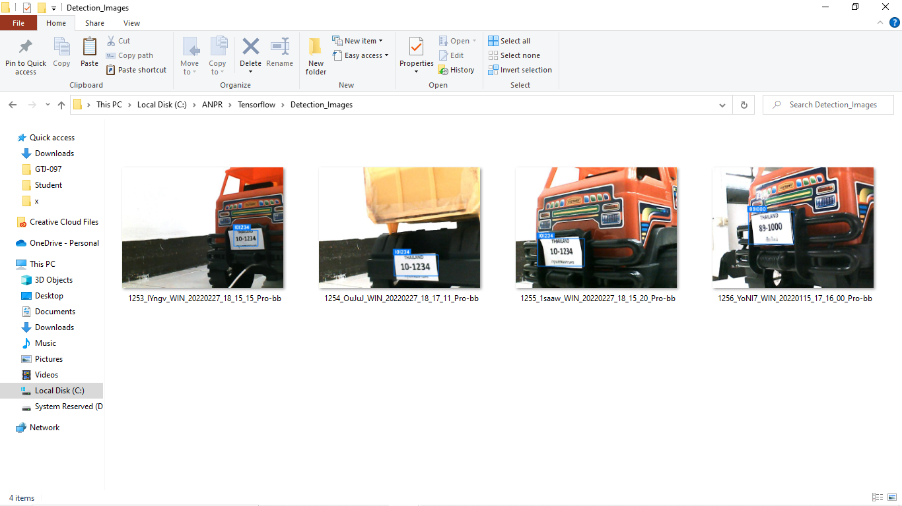
Autonomic number plate recognition

Slide 16
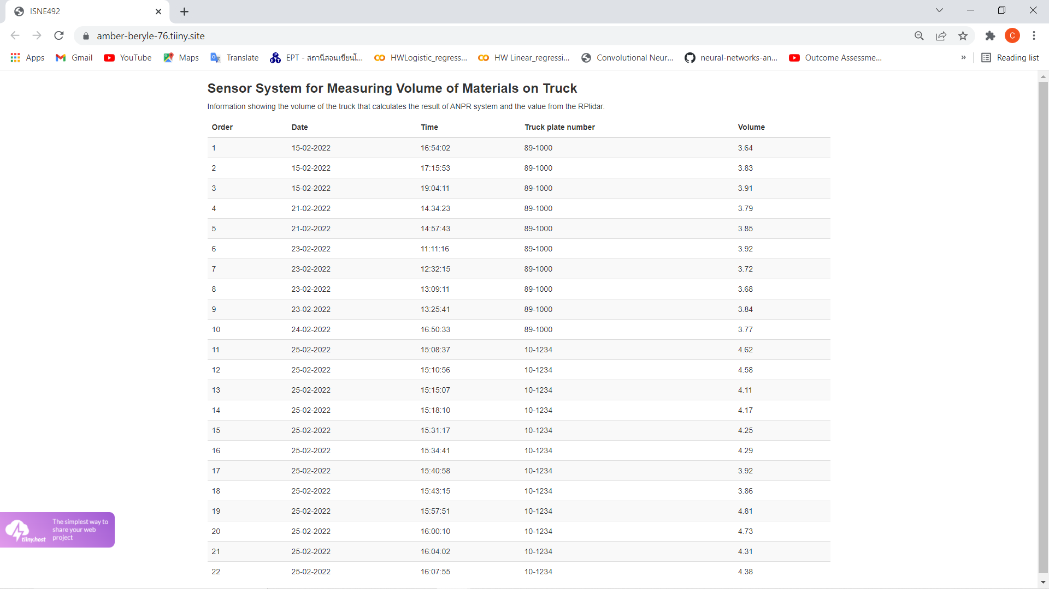
website

Slide 17
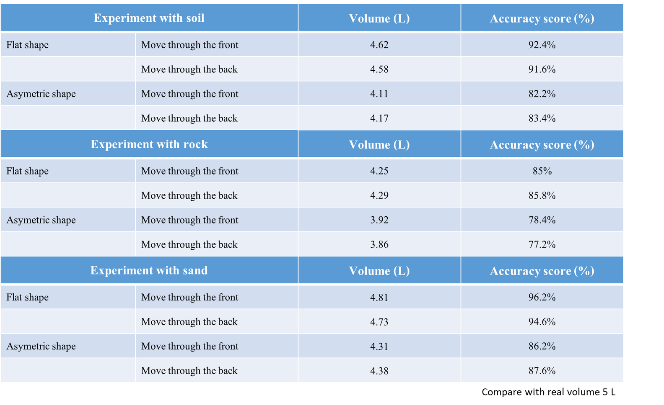
Experiment results
Accuracy score
up to 86%

Slide 18
Conclusion
The function of the truck volumetric sensor system works to reduce the cost of using the truck volumetric meter and to make it easier for the user to operate and manage the equipment. The sensor will receive values that can detect objects well differently. In the other hand, material characteristic with smooth surfaces and less gaps ,the sensor values that receive will acuurate. And we Managed to display image data on the web, in which the web consists of the license plate number and volume obtained from the program to make it more convenient to look at and manage.

Slide 19




